Slide 1

NEOSTRIKE
The Fast Track-Native Integration Platform
For Casino & Sports-Book • Live in 48 Hours

Slide 2
The 6-Week Development Gap
The Challenge
The Market Gap
Technical founders waste 6-8 weeks building game provider adapters, wallet UIs, game lobbies, and payment flows from scratch.
Aggregators lock you into their contracts. Generic tools can't handle real-time gaming requirements.
Dev cycle: 6-8 Weeks
Rigid White-Label stacks with limited flexibility
Sunk costs: €50K-€100K
Slow real-time data sync affecting player experience
FT Sync: 8-12 Weeks dedicated
No native Fast Track support requiring custom builds
Risk: Legacy "afterthought" CRM sync
Industry data shows integration complexity adds 40-60% buffer to vendor timelines

Slide 3

The 48-Hour Advantage Integration Orchestrator for Fast Track casinos
NeoStrike is the Integration Orchestrator for Fast Track casinos and sports-book.
Pre-Built Adapters
BYOC Model
Auto Compliance
Top 3 game providers (Evolution, Pragmatic, NetEnt) + payment orchestration (Adyen, Stripe). Game Catalog API included.
Bring Your Own Contracts. Maintain direct relationships with providers. Keep your commercial leverage.
Tools-powered compliance and responsible gaming built-in. Automated regulatory reporting.

Slide 4
Fast Track CRM Integration
Async Event Streaming
9 Core Event Types
No-Code Configuration
Latency < 10ms to publish all events. Instant sync for every bet, win, and login.
From Registration to KYC. Deduplicated and reliable event delivery to Fast Track.
Connect CRM, test webhooks, and map event logs via the Tenant Portal UI without writing code.
RabbitMQ-powered
Event-driven architecture
Guaranteed delivery (durable queues)
Complete event coverage
Visual workflow builder
No impact on API performance (async)
Automatic deduplication
Instant deployment
NeoStrike publishes events to RabbitMQ in <10ms — Fast Track consumes asynchronously with guaranteed delivery

Slide 5
Maximizing Payment Approval
Adyen (Raw)
91.5%
Stripe (Raw)
90.8%
NeoStrike Orchestrated
99.2%
Geography-Based
VIP Status
Historical Patterns
Smart routing by region
Priority processing
ML-optimized routing
Payment orchestration can boost approval rates by up to 15% and reduce declines below 15%

Slide 6
Pure Serverless Architecture
Single Platform
Vercel
Scales to Zero
Pay Per Use
Auto-Scaling
10-10K Users
Edge Functions
RabbitMQ
Cost Efficient
Global edge network
Async messaging
€54-79/month
Fully serverless architecture with no containers or WebSocket servers—everything scales automatically

Slide 7



Premier Game Provider Adapters
Evolution
Pragmatic Play
NetEnt
Seamless Wallet
250+ Slots & Bingo
Casino API
Live Casino & RNG
Live Games
Branded Games
2-min Setup
Async Event Streaming
High-Retention Slots
More providers coming Q4 2026: Play'n GO, Microgaming, Red Tiger

Slide 8
NeoStrike Starter Kit
Three tools. One command. Production-ready in days.
Game Catalog API
Reference Frontend
@neostrike/sdk
Single Endpoint
React + Tailwind
React Hooks
Single endpoint for 847+ games across all providers. Search, filter, launch in one API call.
React + Tailwind template. Fork, brand, deploy. Pre-built game lobby, wallet UI, auth flows, and RG modals wired to NeoStrike APIs.
React hooks that handle balance, games, payments and alerts. useBalance(), useGames(), usePayments() — 2 lines to wire any component.
One-command scaffold
Game lobby + wallet + auth
TypeScript support
MIT licensed, you own the code
Duty of Care alerts built-in
Published to npm
Without NeoStrike Starter Kit
With NeoStrike Starter Kit
Time Saved
6-8 weeks of boilerplate
Live in 2 weeks
75%

Slide 9
Auto Duty of Care & Compliance
Behavioral Pattern | Detection Logic | Auto-Intervention
Chasing Losses | 5+ consecutive deposits after losses | Reality Check + Cooling-off
Velocity Spike | Bet frequency > 3x baseline | Session Time Alert
Rapid Escalation | Bet size 10x in 30 minutes | Mandatory 5-min Break
Prolonged Session | Continuous play > 90 minutes | Reality Check Notification
Rule-based detection with instant intervention — regulators require explainability, not black-box ML
2026 regulations mandate algorithm-based risk monitoring in Brazil, Germany, Italy

Slide 10
Hands-Off Regulatory Compliance
UKGC Monthly Returns
MGA Player Protection
Automatically generated on the 1st of every month. Ready for download or SFTP delivery.
Quarterly reports covering player protection and RG metrics auto-compiled via API.
MRR Compliance
API Integration
Curaçao Compliance
7-Year Audit Trail
Annual compliance reports generated every Jan 31st with full fair-gaming RNG verification.
Full event-level data retention. On-demand exports in CSV/JSON for any audit request.
RNG Verified
Full Retention
Compliance automation reduces administrative burden by 85% while ensuring full regulatory adherence

Slide 11
Mission-Critical Performance
99.8%
100ms
<10ms
API Uptime
API Response
RabbitMQ Publish
Guaranteed SLA
for player balance updates via stateless responses
RabbitMQ Publish
End-to-End Latency Target
Ladapter
+
Lpublish
< 100ms
Auto-scaling infrastructure
Multi-region deployment
24/7 health monitoring

Slide 12
Enterprise Security & BYOC Model
The BYOC Moat
Military-Grade Security
NeoStrike is a Technical Service Provider (TSP). We never touch player data or wallet custody—you maintain full control and compliance
AES-256 Encryption
All credentials secured
No Game Aggregator Markups
TLS 1.3
Keep your margins intact
In-transit protection
Player Data Ownership
You own player data, we process events
Isolated Vaults
Merchant of Record Status
Credentials never co-mingled
Full commercial ownership
Certifications
ISO 27001, PCI DSS, SOC 2

Slide 13
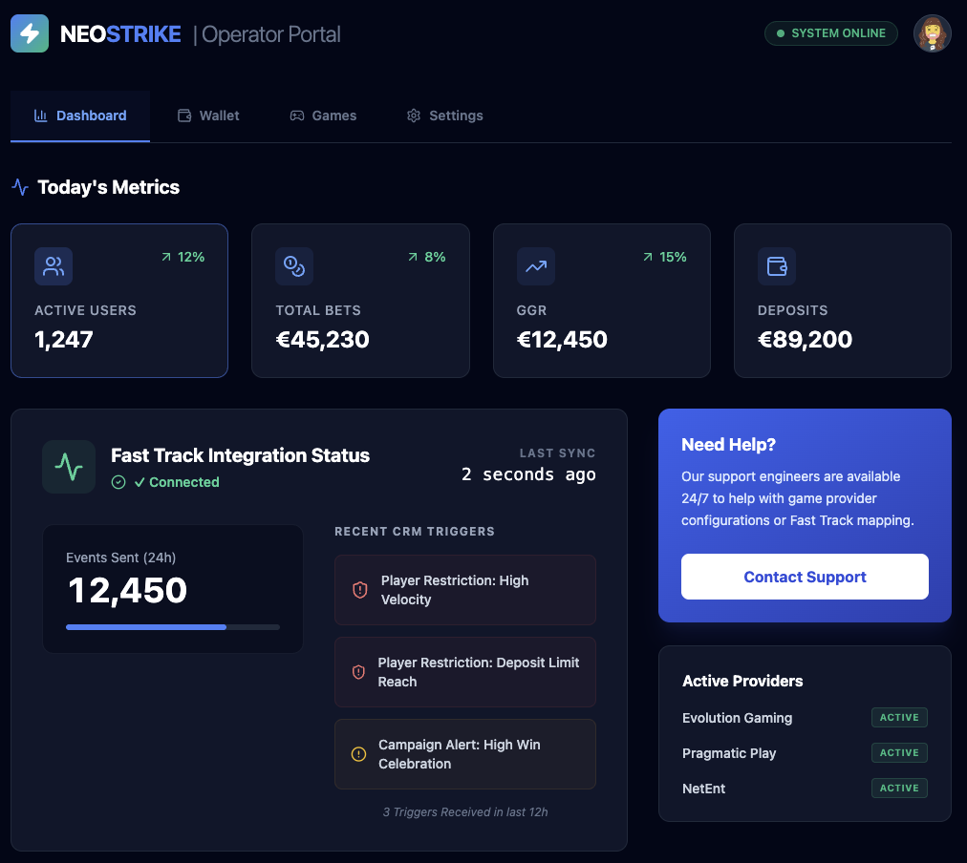
No-Code Tenant Portal
Instant GGR & Performance
Live metrics dashboard with customizable KPIs and automated reporting
Self-Service Provider API
Manage game and payment provider connections without engineering support
Scoped API Key Generation
Granular access control with role-based permissions and audit trails
Affordability Check Status
Real-time player financial health monitoring with automated alerts
No database access or complex queries required. Total control through intuitive UI.

Slide 14
Pricing & Scalability
Most Popular
GROWTH
STARTUP
€2,500/mo
ENTERPRISE
€0/mo
CUSTOM
+ 2.0% GGR
+ 2.5% GGR
+ 1.5% GGR
Ideal for new operators entering the market
Most popular for established iGaming B2C brands
High-volume operators requiring dedicated support
Everything in Growth
Core integrations
All integrations
Dedicated account manager
Standard support
Priority support
Custom SLAs
Community access
AI compliance tools
White-label options
Advanced analytics

Slide 15
Development Roadmap 2026
Q1
Q3
Core Build
Beta & Pilots
Q2
Q4
Weeks 1-12: RabbitMQ, Provider Adapters (3), Payments (2), Fast Track
Onboard 3 pilot operators, gather feedback, performance hardening
Launch
Scale
Foundation
Weeks 13-18: Game Catalog API, Reference Frontend (React), SDK
Innovation
Post-Launch: More Providers, ML Upgrade, Certifications
Go-Live
Expansion
48-Hour Launch
Global Ready
Continuous Updates
2-week launch using reference frontend + your branding
Multi-jurisdiction support
Monthly feature releases

Slide 16

Questions?
Secure your 48-hour launch advantage today
contact@neostrike.io
www.neostrike.io
LIVE IN 48 HOURS

